Slide 1


Slide 2
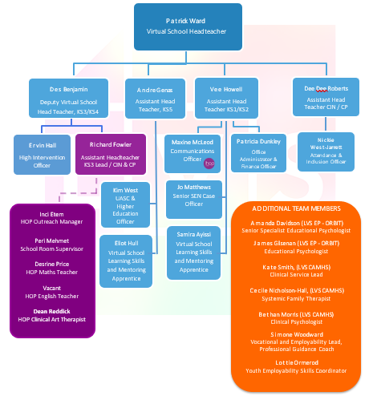
Lewisham Virtual School Team Structure

Slide 3

What Does The Virtual School Do?

Slide 4
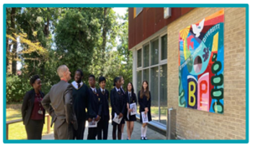
What Does The Virtual School Do?
Educational lead professionals for CLA/CIN/CP – Kinship Care
Supports YP with their social, emotional and mental health
Advice and guidance for PLAC/PP
Focus on Early Intervention and Prevention for pre-care cohorts
Admissions and attendance support
Promotes inclusive practice in schools:

Slide 5

The Role of the Designated Teacher
The advocate for CLA in school
Liaising with the Network/(com)
Promoting a culture of high expectations
To understanding the impact of trauma- https://the-arc.org.uk/
Responsible for the development and review of (PEPs).
To understanding how trauma effects educational achievement.

Slide 6

Strategies for raising attainment
Targeted interventions/Effective use of Pupil Premium Plus (PP+).
Access to tutoring, mentoring, counselling and enrichment
Personalised learning
Monitoring progress and identifying barriers to learning.
Monitoring academic progress and attendance

Slide 7
Attendance and Reducing Exclusions
Identifying and addressing attendance barriers
Trauma informed approaches to reducing exclusions
Implementing strategies to improve attendance
Understanding EBSNA - (2024) Emotionally Based School Non-Attendance
Monitoring academic progress and attendance
To understanding EBSNA effects educational achievement.

Slide 8
Case Study
Identifying and addressing attendance barriers
A CLA, Liam, in a residential care setting, has frequent absences from school, particularly after visits with his family. While staff initially suspect truancy, it becomes clear that Liam experiences intense emotional distress – flashbacks and nightmares – after these visits, triggered by memories of past abuse. This emotional distress, linked to his past trauma and exacerbated by family contact, leads to school non attendance.

Slide 9

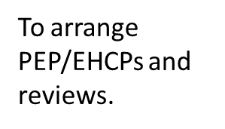

The role of the Social Worker
Lead professionals for CLA
Supports YP with their social, emotional & mental health
Ensuring regular communication between all professionals
Admissions and attendance support.
Promotes inclusive practice in schools

Slide 10
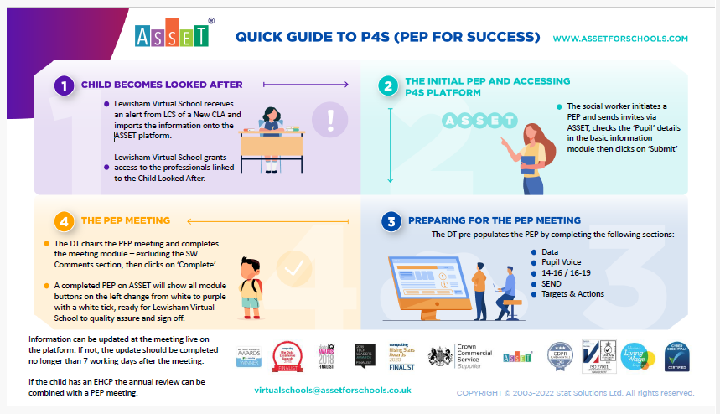

Slide 11
Who do we work with?
Virtual School and SEND
All young people with a Social Worker to Lewisham from early years to year 13
All Lewisham and out of borough schools that have a child in care to Lewisham
Lewisham CSC,
Fostering services
SEND,
CAHMS
Teachers and School Staff
Social Workers
Foster Carers
Health Professionals (e.g., therapists, counsellors)
Educational Psychologists
Careers Advisors
Independent Reviewing Officers
Other Support Workers (e.g., mentors, advocates)

Slide 12
What we don’t do
Virtual School and SEND
Provide ICT equipment
Arrange transport to and from school
Provide tuition as an alternative to school

Slide 13


LVS Annual Conference 2025

Slide 14
Student Outcomes
Examples of positive student outcomes for CLA
Highest ever performance in GCSE exams in 2022/23
All A level students able to enter first choice university. Highest number of students entering university directly from key stage 5.
Unauthorised absence continues to be under 5% of cohort
Total number of days lost to suspensions remains below 1%

