Slide 1
Trauma and Mental Health
Bianka Kuhn

Slide 2
Introductions
YoungMinds is the UK’s leading charity fighting for a future where all young minds are supported and empowered, whatever the challenges.

Slide 3
What is mental health?
The strength and capacity of our minds to grow and develop, to be able to overcome difficulties and challenges and to make the most of our abilities and opportunities
YoungMinds, 2006

Slide 4
Child & Adolescent mental health
A capacity to enter into, and sustain, mutually satisfying and sustaining personal relationships
Continuing progression of psychological development
An ability to play and to learn so that attainments are appropriate for age and intellectual level
A developing moral sense of right and wrong
A degree of psychological distress and maladaptive behaviour within normal limits for the child’s age and context
A clear sense of identity and self worth

Slide 5
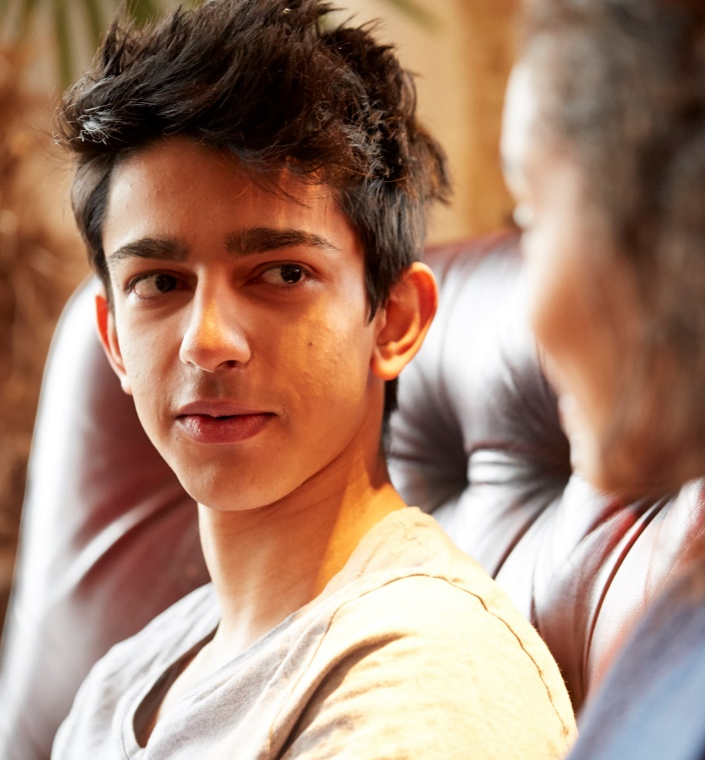
A bio-psycho-social model
NATURE
(what we are born with)
EVENTS
(what happens
to us)
NURTURE
(what we grow
up with)
Notes:
Ask group to think about all the different things that make the children who they are today

Slide 6
Mental health continuum
Coping well Thriving
Not coping
Mental Illness
Languishing
Moderately mentally healthy
Complete mental health
Flourishing

Slide 7
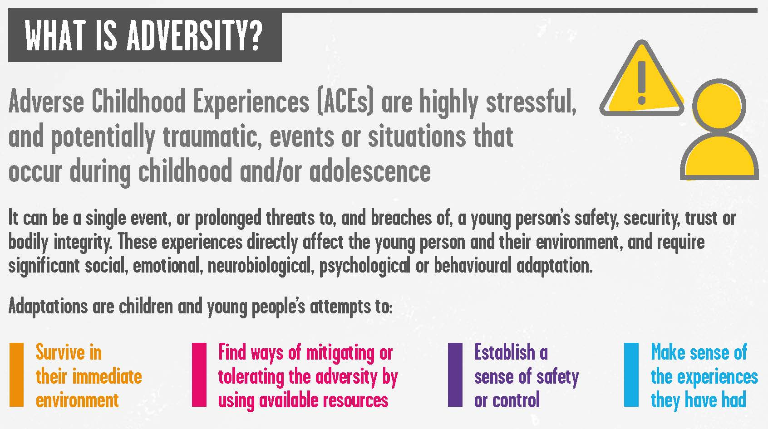
Adversity

Slide 8
What is Trauma
Trauma ‘pierces or wounds our psychological defences’
Psychological trauma occurs as a result of a severely distressing event (traumatic event)
Result of an overwhelming amount of stress that exceeds one's ability to cope, or integrate the emotions involved with that experience
Notes:
Trauma can be both, single event and chronic adversity

Slide 9
Traumatic events
Events that involved actual or threatened death, serious injury or a threat to the physical integrity to self or others
Events that challenge a basic fundamental belief. The greater the contradiction between what has happened and the belief the more likely the event will be traumatic
An event that creates intense fear, horror, or a sense of helplessness
The event can be experienced or witnessed

Slide 10
Impact of trauma
In the face of interpersonal trauma, all the systems of the social brain become shaped for offensive and defensive purposes.
A child growing up surrounded by trauma and unpredictability will only be able to develop neural systems and functional capabilities that reflect this disorganisation.
Source: National CAMHS Support Service, Everybody’s Business

Slide 11
Effects on brain development and function
These functions may be diminished or lost:
Language, especially spoken language
Words for feelings
Sense of meaning and connection
Empathy
Impulse control
Mood regulation
Short term memory
Capacity for joy

Slide 12
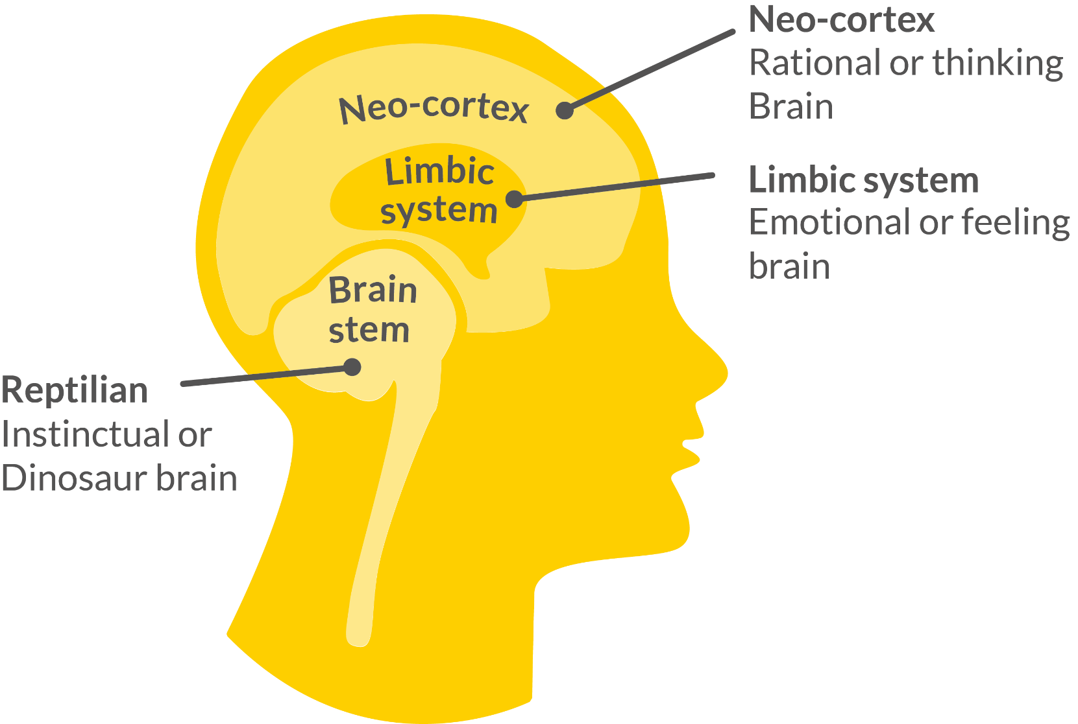
Effects on brain development and function
In other words:
The brain “shuts down” all non-essential functions within the Neocortex and limbic system

Slide 13
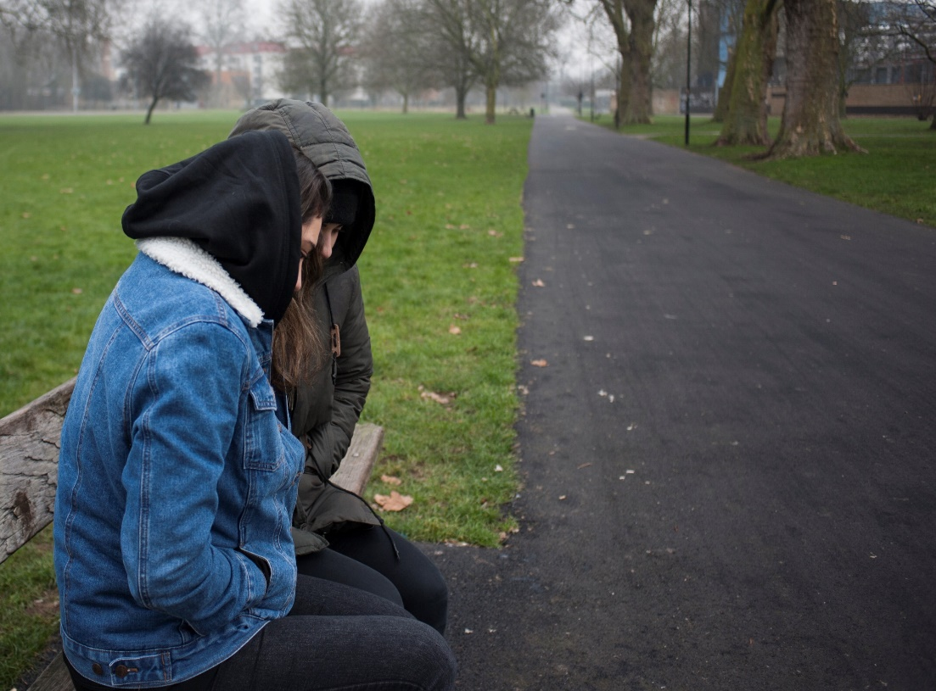
Trauma and behaviour
Many of the distressing behaviours we see are attempts to survive and cope within a dangerous world

Slide 14
Trauma and behaviour
VS
Appearing to cope
Coping
Notes:
Keeping in mind that sometimes those who appear to be coping may not.

Slide 15
What are ACE’s
• Physical abuse
• Sexual Abuse
• Emotional Abuse
• Living with someone who abused drugs
• Living with someone who abused alcohol
• Exposure to domestic violence
• Living with someone who was incarcerated
• Living with someone with serious mental illness
• Parental loss through divorce, death or abandonment
Notes:
http://www.npr.org/sections/health-shots/2015/03/02/387007941/take-the-ace-quiz-and-learn-what-it-does-and-doesnt-mean

Slide 16
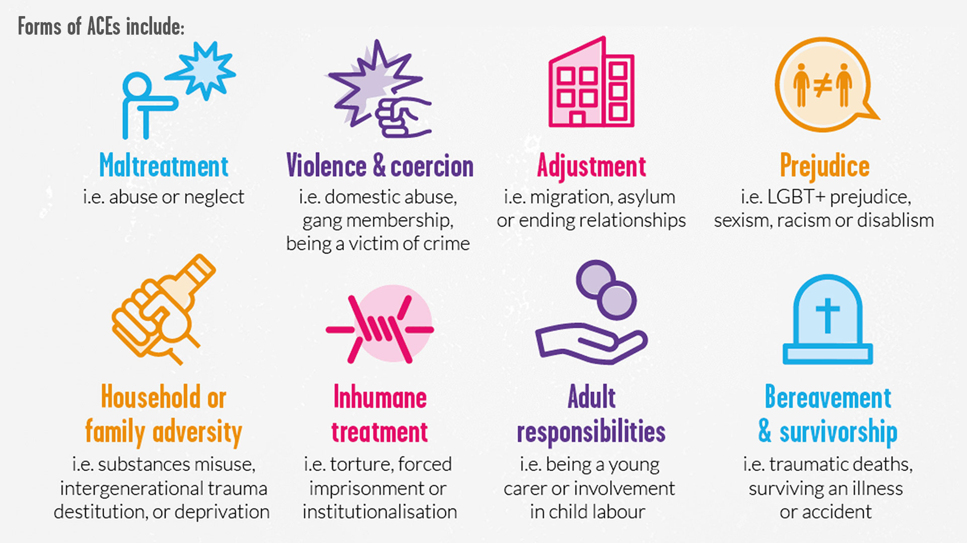
ACE’s continued

Slide 17
How common are ACE’s

Slide 18
ACE’s impact on life
Notes:
From: http://www.acesconnection.com/blog/the-70-30-campaign

Slide 19
Traumatic stress
The automatic response to trauma, involving the production of toxic amounts of stress hormones which affect:
Brain function
All major body systems
Social functioning
A bio-psycho-social injury

Slide 20
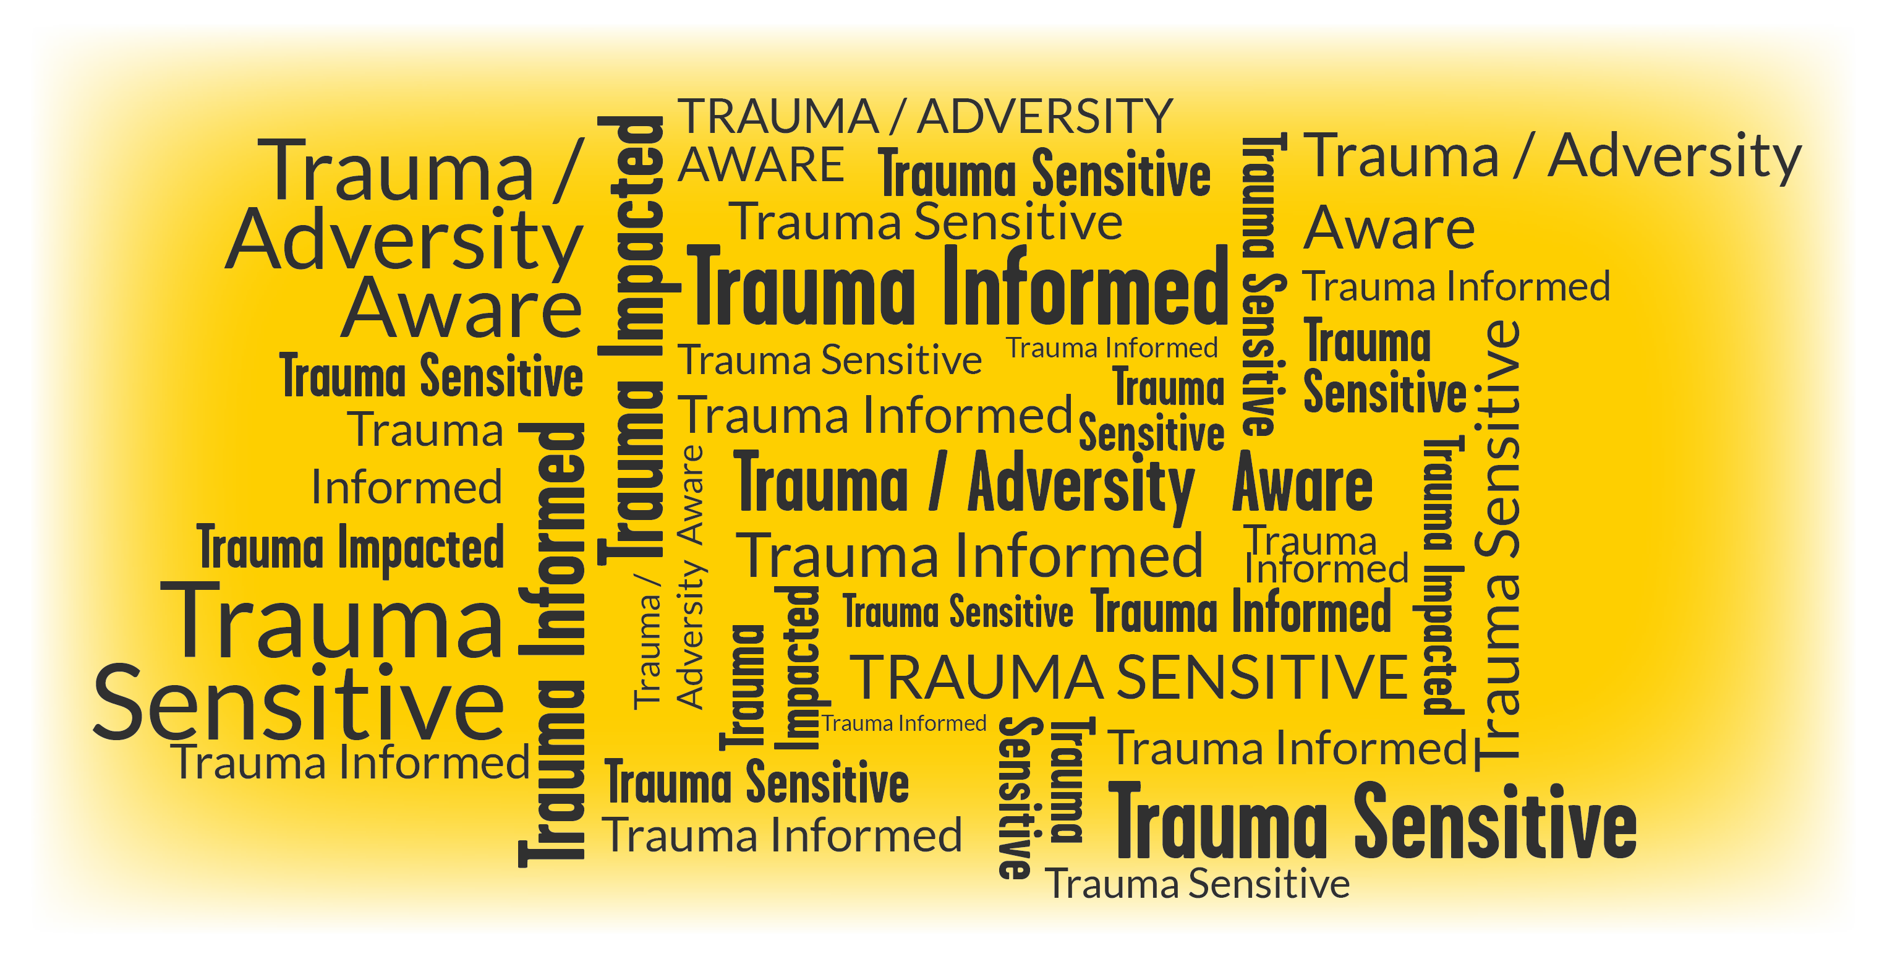
What are we?
Trauma Impacted?
Trauma / Adversity Aware?
Trauma Sensitive?
Trauma Informed?
Notes:
Who decides? What are the differences? How do we understand the different terms?

Slide 21
Working with Adversity and Trauma
Notes:
Trainer to explain scenario: “I’m 15yrs old, my parents moved house 9 times since I was born, our last house was repossessed and they are bankrupt. I feel bullied at school and don’t like going. I’m failing most of my subjects”
Ask participants in big group to explain how they would respond and how they would like to respond (honestly); what are their first thoughts?
What is the emotional impact of this work?

Slide 22
Working with Trauma: Compassion Fatigue
TEDx Talk:
Drowning in Empathy: The Cost of Vicarious Trauma Amy Cunningham
https://www.youtube.com/watch?v=ZsaorjIo1Yc
Notes:
Amy Cunningham has spent twelve years working with non-profits and mental health organizations, focused on assisting adolescents in overcoming trauma and redefining their lives. In 2011, she developed the Compassion Fatigue training program for the Center for Health Care Services, Bexar County’s community mental health agency. She currently serves as a talent management consultant for CHRISTUS Health and leads a team dedicated to the implementation and planning of all leadership development programs. Amy pioneered the development of Compassion Fatigue training for CHRISTUS and has had the honor of training over 3000 people across the nation.

Slide 23
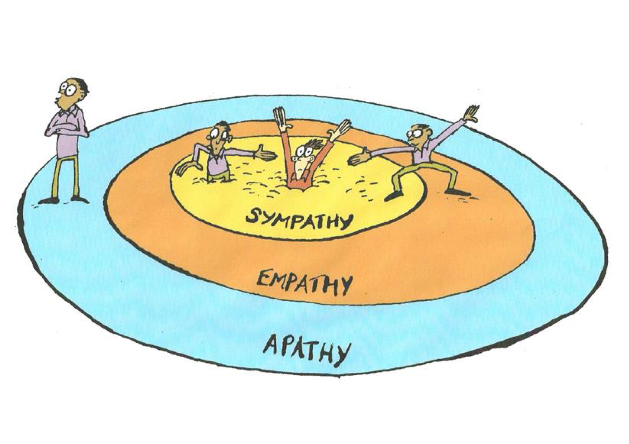
Trauma impacted systems
Where are you?
Who are you holding?
Who is holding you?
Notes:
Trauma impacts Families, Professionals & Systems

Slide 24
Navigation and negotiation
In the context of exposure to significant adversity, resilience is both the capacity of individuals to navigate their way to the psychological, social, cultural, and physical resources that sustain their well being, and their capacity individually and collectively to negotiate for these resources to be provided and experienced in culturally meaningful ways.
Ungar, 2008

Slide 25
Resilience: The human capacity…
…to face, overcome and ultimately be strengthened and even transformed by life’s adversities and challenges .. a complex relationship of psychological inner strengths and environmental social supports
Masten, A. S. ()

Slide 26
Pragmatically
The kinds of things we need to make happen (e.g. events, parenting strategies, relationships, resources) to help children [or anyone] manage life when it’s tough. Plus ways of thinking and acting that we need ourselves if we want to make things better for children [or adults].’
Source: Aumann and Hart 2009

Slide 27
Resilience is not:
A panacea
A quick fix
Just about individual skills

Slide 28
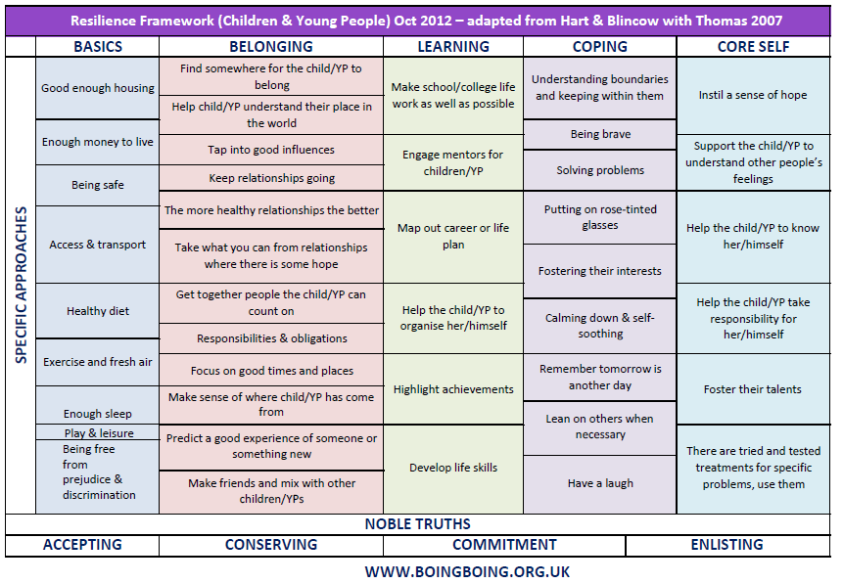

Slide 29
Further viewing:
Why We Need Trauma-Sensitive Schools: https://www.youtube.com/watch?v=vyQdOLl6d2c&feature=youtu.be
The paradox of trauma-informed care | Vicky Kelly https://www.youtube.com/watch?v=jFdn9479U3s&t=21s
How childhood trauma affects health across a lifetime | Nadine Burke https://www.ted.com/talks/nadine_burke_harris_how_childhood_trauma_affects_health_across_a_lifetime
The Repair of Early Trauma: A Bottom Up Approach | Beacon House https://www.youtube.com/watch?v=FOCTxcaNHeg

Slide 31
Tel: 020 7089 5050
Parents Helpline: 0808 802 5544
Website & Publications: youngminds.org.uk
Training & Development: training@youngminds.org.uk

